Slide 1

Dairy Products Online E-commerce Store
Team 4:
Duan Lin
Bhavesh Tadikonda
Shuyi Zheng
Shreyas Prakash
Hussain Alibrahim
Ming Yuan
Neha Jadhav Sarnaik

Slide 2


Topics of Iteration 1
Front-End：
Design & UI
Implementation & Technical Stack
Requirement analysis
Design & Implementation
Testing & QA management
Configuration & Deployment
Security
Project Management
Future Work
Demo
Back-End :
Sign up & Login
Manually Login
Third Party Login
Database
YAML to MongoDB

Slide 3
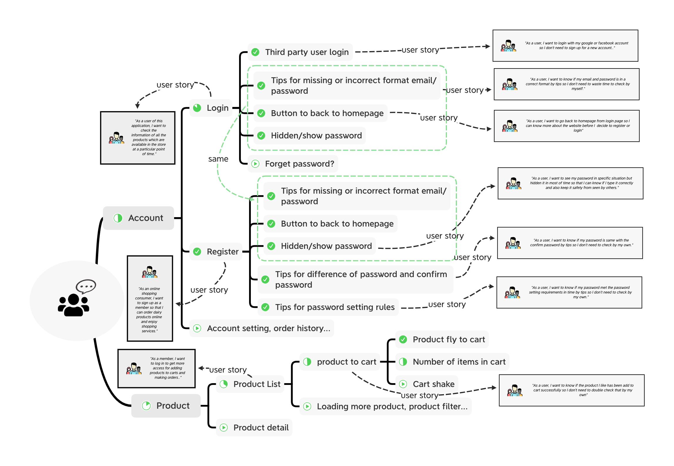
Requirement
Analysis

Slide 4
Front-End Design
What features did we use to build an easy to use and responsive User Interface?
A Navbar was applied to make the transition between pages easier
Product Cards were implemented so Customers can have a brief glimpse at the products available
Easy to use log in that also incorporates facebook and google logins for easy entry
How do the features enhance the User Experience?
We use the pictures of our products in our Product Cards to catch the customer’s eye and lead them to clicking on the product of interest.
In terms of login, for those who want to streamline the sign up experience, they may rely on google or facebook, but they can still sign up too through our site
What can be improved?
The navbar still has trouble with mobile viewing, so we need to implement the navbar into the mobile view without compromising the User Experience.

Slide 5
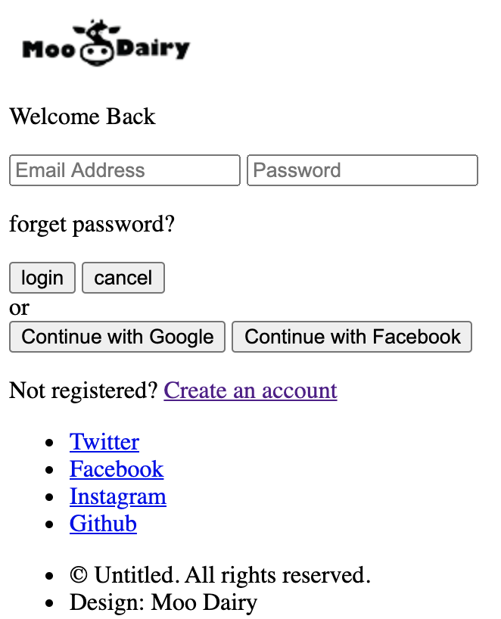
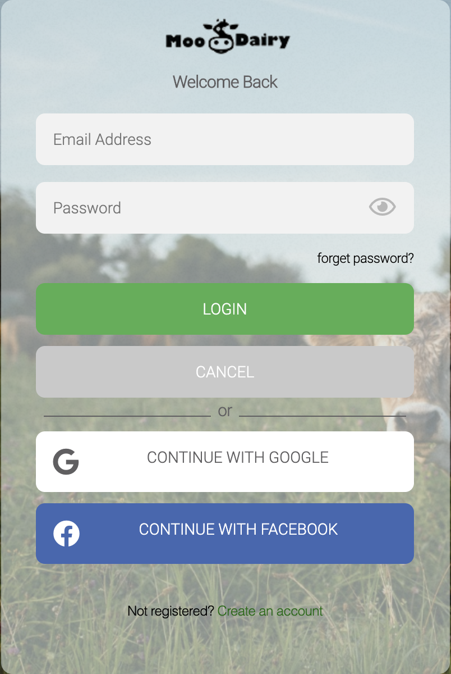
Front-End Implementation
index.html
login_register.js
main.css
login.html
cart.js
fontawesome-all.min.css
register.html
layer.js
products.html
jquery.fly.js
jquery.fly.min.js
jquery.validate.js

Slide 6
Back-End Design
Front-End send request (Controller level) -> Flask functions (Service level) -> MongoDB Operations(DAO level, Data Access Object) -> Flask get response from DAO -> Front-End receive and render HTML page.
How to manage new users?
Set up two collections in MongoDB: OAUTH_USER_DETAILS, USER
OAUTH: From Google Login, identify by Google account
USER: From Website manual login, use email address
How to separate “Service level” and make it readable?
app.py - run the server, contain routes: /, /index
login.py - handle login request, routes: /login, /login-result
register.py - handle register action, routes: /register, /register-result
product.py - show products and cart action, routes: /products

Slide 7
Back-End Implementation
RestFul API’s are being built which integrates the front end with the MongoDB.
The sequence of operation is as follows :
app.run(host=’127.0.0.1’, port=5000, debug=True)
which initializes the main route and renders index.html
Get the href corresponding to the list item Login(mainly login button)
This will render login.html.
Now we have google sign in option(button). After we click that
Now the control redirects to ‘/login’ route.
After selecting appropriate Gmail ID
Verification of correct Gmail ID by OAuth which then changes the control to ‘/authorize’ route.
Receive all profile information of the user entering the application and place dynamically on MongoDB.
Databases
There are 3 collections on MongoDB:
OAUTH_USER_DETAILS
Collection used to store user login details done by Google Sign In.
User
Collection used to store Manual Sign up user login details.
Product
Collection used to store product information of all the products.
Here we have used YAML format which has been parsed to JSON and stored on product collection.

Slide 8
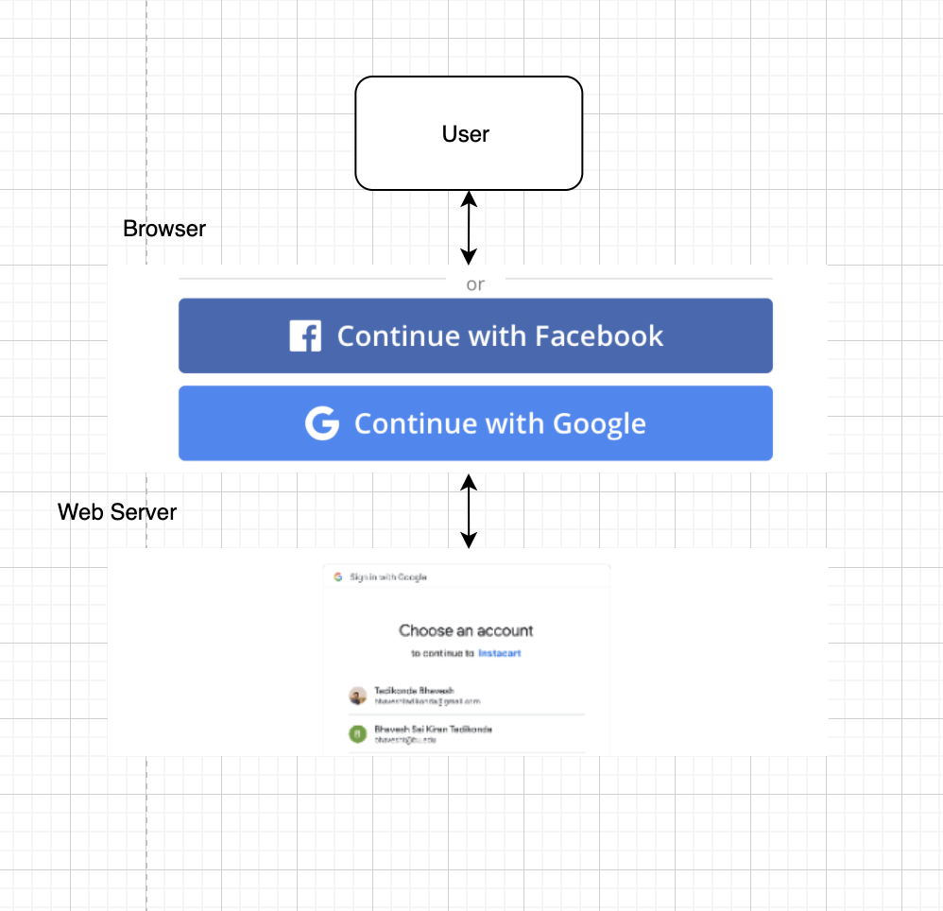
OAuth 2.0 - Authorization code flow
Back-End Implementation
User will be authorized using google third party API.
OAuth 2.0 flow
Endpoints and Website
Google.com
/authorize
/token
/userinfo

Slide 9
Testing and QA management
Now, please let me briefly show how to use our website
Test:
Register:
Blank input fields: web page pops up warning messages when click “submit”
Invalid email address: format using Regex from both side
Invalid password and prompt warnings:
A lowercase letter
A capital letter
A number
Length between 8 to 20
Password confirmation

Slide 10
Configuration and Deployment
Our github set up is structured in two parts: Frontend and Backend
Both essentially use the same structure:
Everyone has their own branch where they work on features assigned to them.
Code can only be pushed after screening the code with at least 2 people.
If all branches are ready to be merged in an end, they merge onto the leader’s branch:
Backend: Duan Lin
Front End: Shuyi Zheng
Once we’re ready for deployment, we check both ends and if everything checks out, we merge both front end and back end into master.

Slide 11
Security
Security Issues and mitigation measures
Weak password
Reinforce the strength of password！
Password Leak
Encrypt the password and hide the mechanism!
Illegal visit to database
Keep the credential safe！

Slide 12
Project Management
Agile model
Requirement gathering Stage
Design the requirements Stage
Iteration Stage
Testing the application Stage
Deployment Stage
Feedback Stage

Slide 13
Future Work
Checking for the product information
Adding a product into the cart
Removing selected products from the cart
Editing default delivery address
Adding payment option
Customer Service page
Checking for order history

Slide 14

Thank You !

